Slide 1

Hiring and Inspiring an Exceptional Team
Seth Petry-Johnson
@spetryjohnson
A primer for early-career leaders
Notes:
Quick room survey before we get started.
Is there anyone here who has been in a management or leadership role for more than 2 years?
Anyone here newly promoted into management or leadership?
Anyone hoping to break into a management or leadership role, but not there yet?

Slide 2
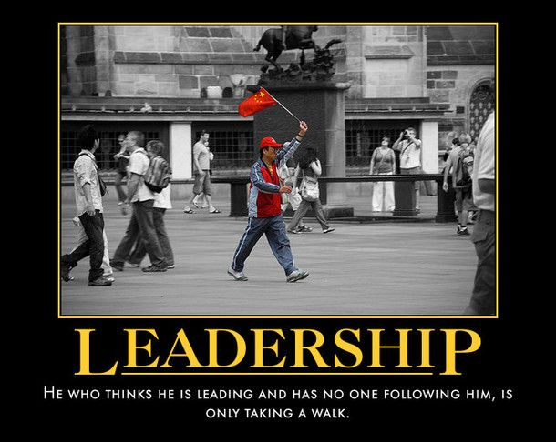

Slide 3


Slide 4
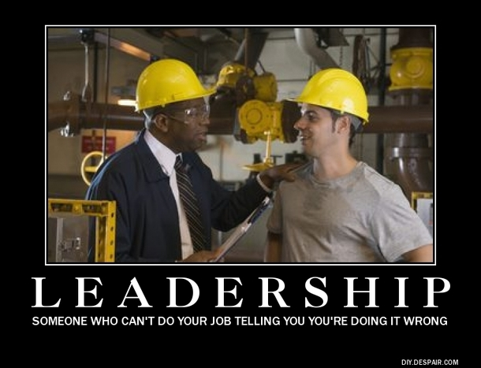

Slide 5
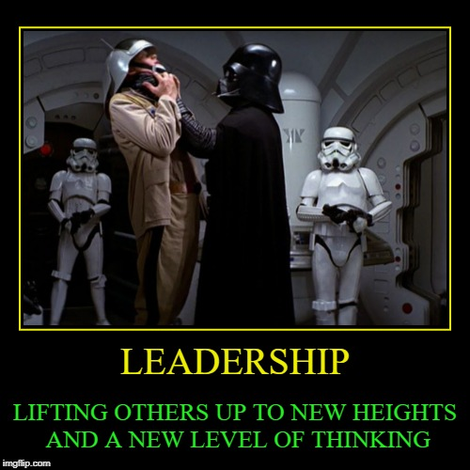

Slide 6
Hiring and Inspiring an Exceptional Team
Seth Petry-Johnson
@spetryjohnson
A primer for early-career leaders
Notes:
Quick room survey before we get started.
Is there anyone here who has been in a management or leadership role for more than 2 years?
Anyone here newly promoted into management or leadership?
Anyone hoping to break into a management or leadership role, but not there yet?

Slide 7
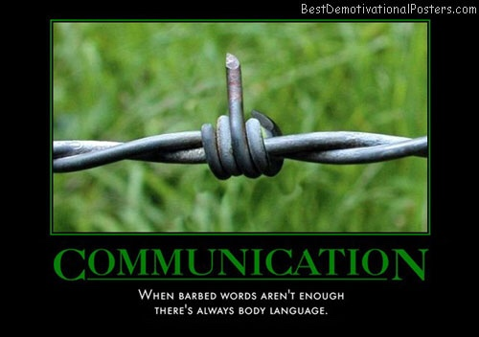

Slide 8


Slide 9


Slide 10


Slide 11


Slide 12
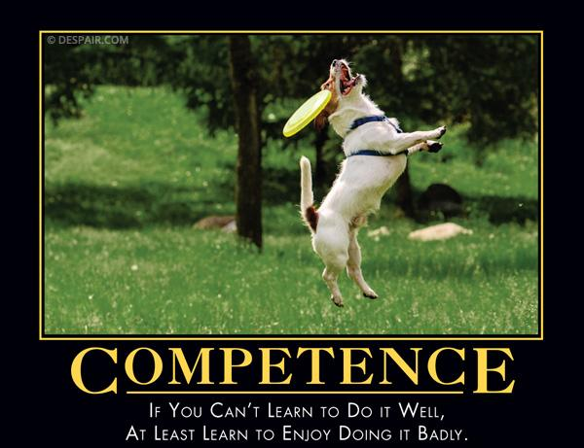

Slide 13


Slide 14
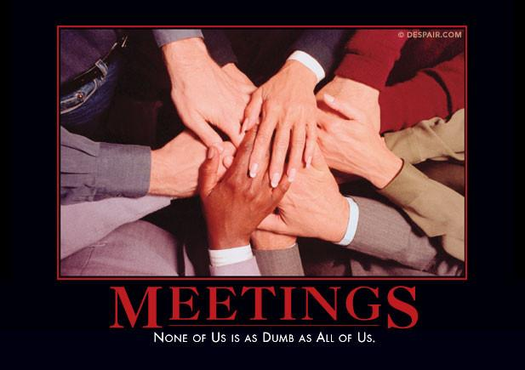

Slide 15
Hiring and Inspiring an Exceptional Team
Seth Petry-Johnson
@spetryjohnson
A primer for early-career leaders
Notes:
Quick room survey before we get started.
Is there anyone here who has been in a management or leadership role for more than 2 years?
Anyone here newly promoted into management or leadership?
Anyone hoping to break into a management or leadership role, but not there yet?

Slide 16
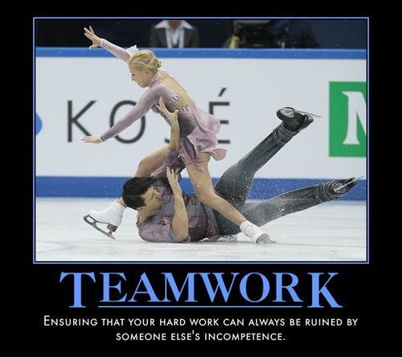

Slide 17
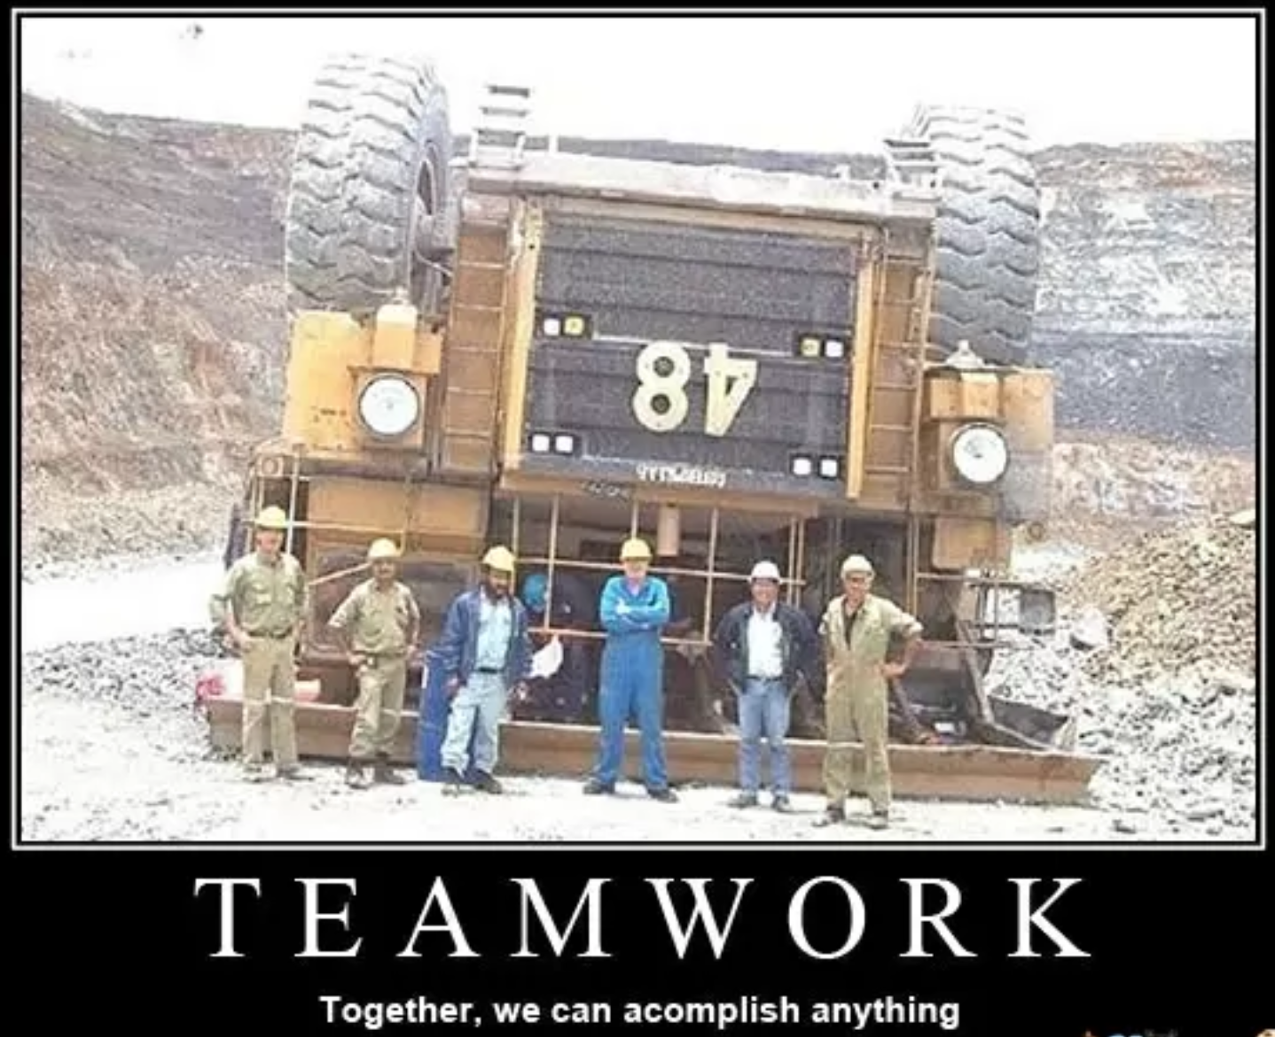

Slide 18
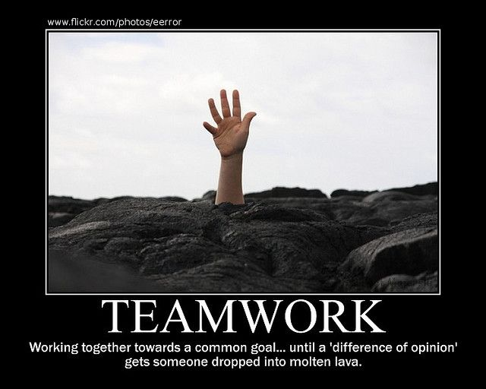

Slide 19
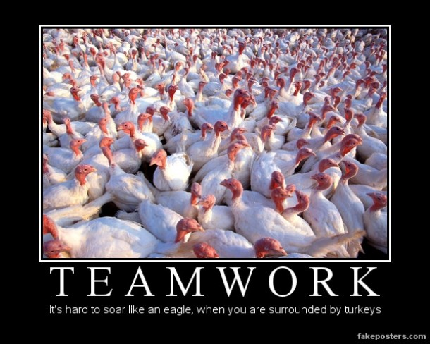

Slide 20
Hiring and Inspiring an Exceptional Team
Seth Petry-Johnson
@spetryjohnson
A primer for early-career leaders
Notes:
Quick room survey before we get started.
Is there anyone here who has been in a management or leadership role for more than 2 years?
Anyone here newly promoted into management or leadership?
Anyone hoping to break into a management or leadership role, but not there yet?

Slide 21
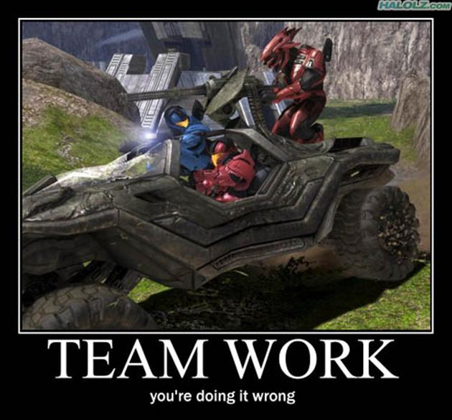

Slide 22
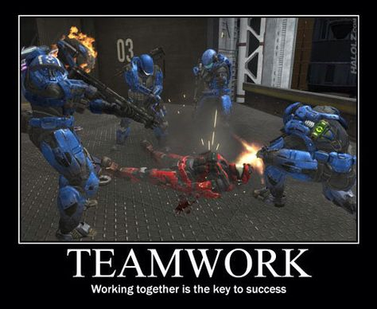

Slide 23
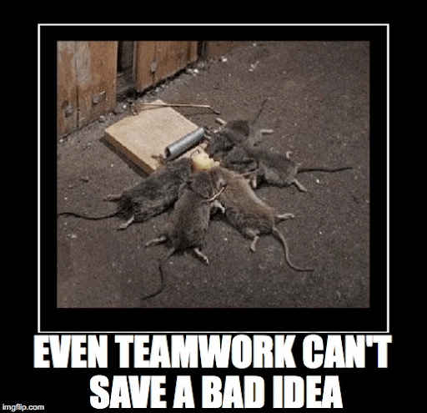

Slide 24
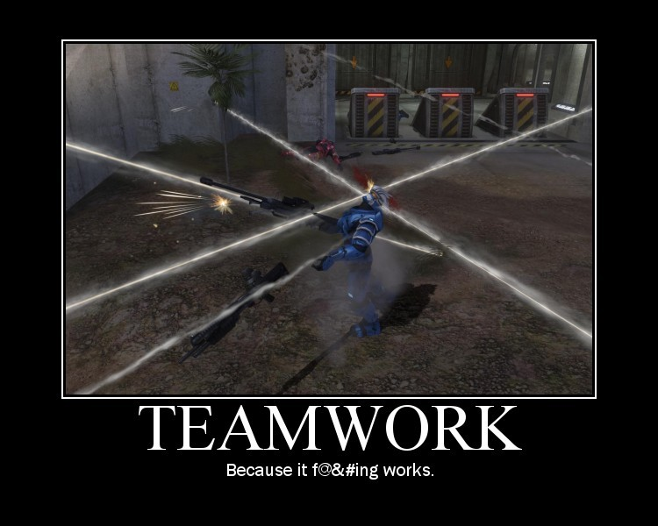

Slide 25
Hiring and Inspiring an Exceptional Team
Seth Petry-Johnson
@spetryjohnson
A primer for early-career leaders
Notes:
Quick room survey before we get started.
Is there anyone here who has been in a management or leadership role for more than 2 years?
Anyone here newly promoted into management or leadership?
Anyone hoping to break into a management or leadership role, but not there yet?

Slide 26
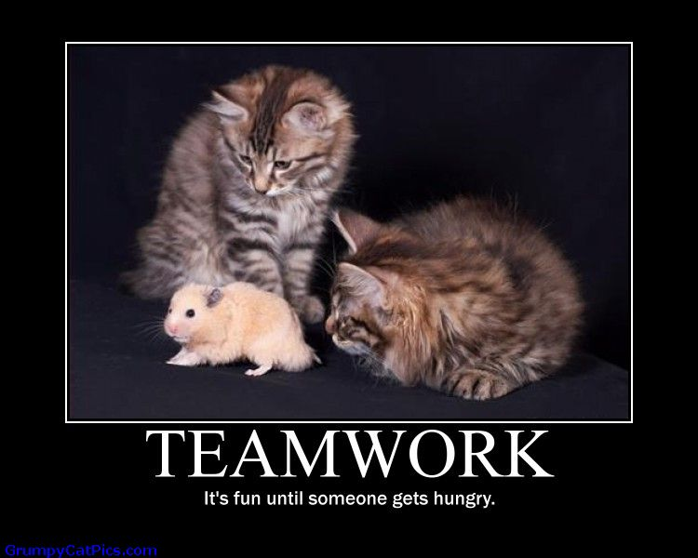

Slide 27
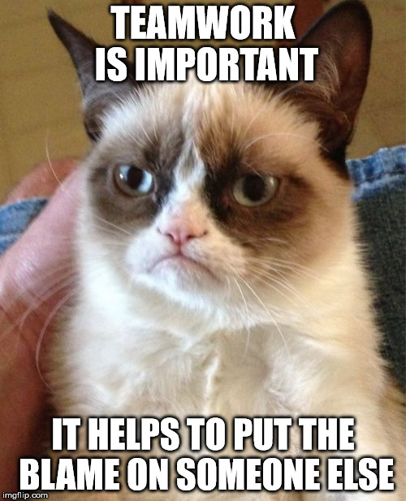

Slide 28
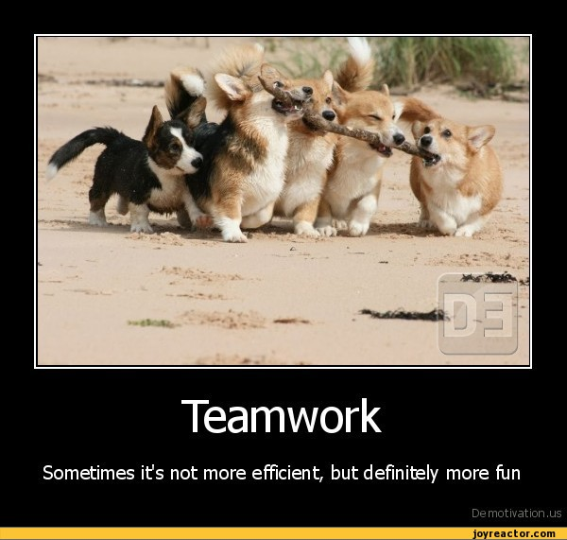

Slide 29
Hiring and Inspiring an Exceptional Team
Seth Petry-Johnson
@spetryjohnson
A primer for early-career leaders
Notes:
Quick room survey before we get started.
Is there anyone here who has been in a management or leadership role for more than 2 years?
Anyone here newly promoted into management or leadership?
Anyone hoping to break into a management or leadership role, but not there yet?

Slide 30
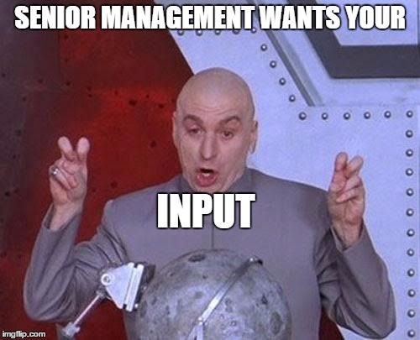

Slide 31


Slide 32
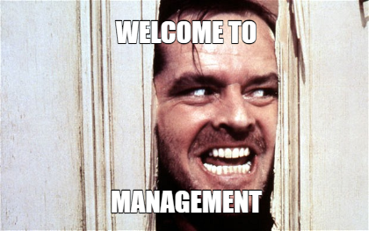

Slide 33
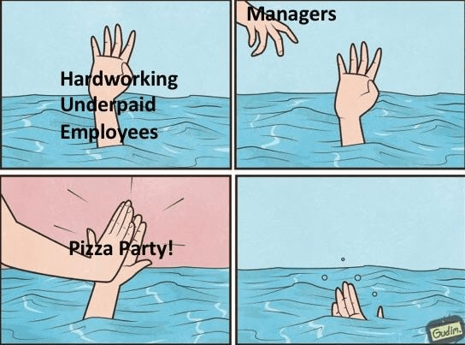

Slide 34
